Slide 1
Digital System
Chapter III. Gate-Level
Minimization
고려대학교
전기전자전파공학부
최 린

Slide 2

Map Simplification
Although the truth table representation of a function is unique, there are many ways of representing the function in algebraic expression or in circuit diagram
Boolean algebra can be applied to simplify an expression, but for highly complex functions, finding the best expression is very difficult because
  The simplification procedure is awkward since it lacks specific rules to predict the next step
  It is also difficult to determine whether the simplest expression has been achieved

Slide 3
Map Simplification
Karnough map (K-map)
  Provide a straightforward procedure for simplifying Boolean functions of up to 4 variables
  (5 or 6 variables can be drawn, but cumbersome to use)
  Handles simplification for two-level implementation (sum-of-products or product-of-sums), but do not apply for the general case of 3 or more levels

Slide 4
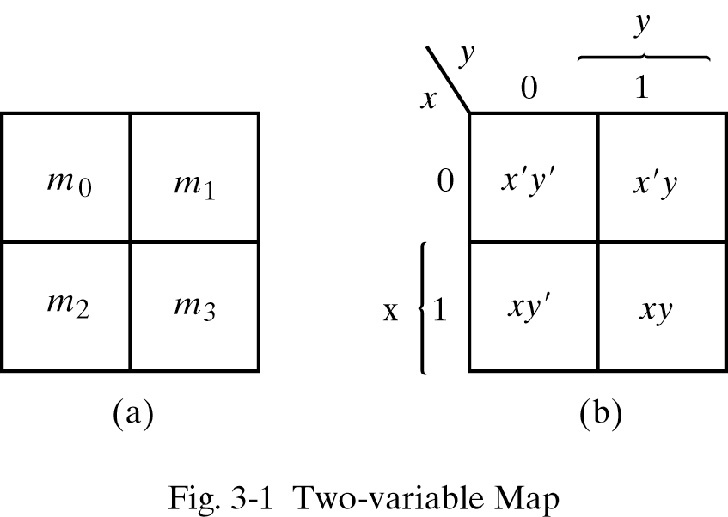

Map Simplification
Two-variable map
  Four minterms for a Boolean function with 2 variables
  A diagram of squares, each representing one minterm
    Any two adjacent squares placed horizontally or vertically form a rectangle corresponding to the sum of two minterms that differ in only a single variable
    Adjacent cells differ by only 1 bit

Slide 5
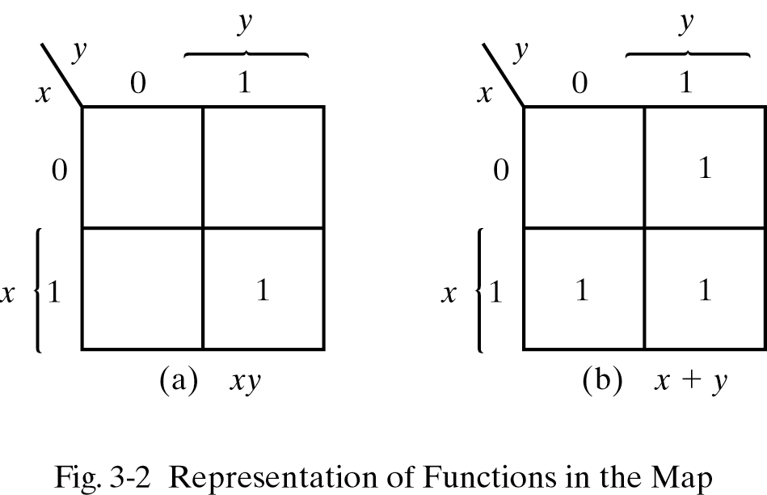
Map Simplification
  (Ex) By algebra
  m1+m2+m3 =
  X'Y+XY'+XY =
  X'Y+X(Y'+Y) =
  X'Y+X =
  X’Y+XY+X =
  X+Y

Slide 6
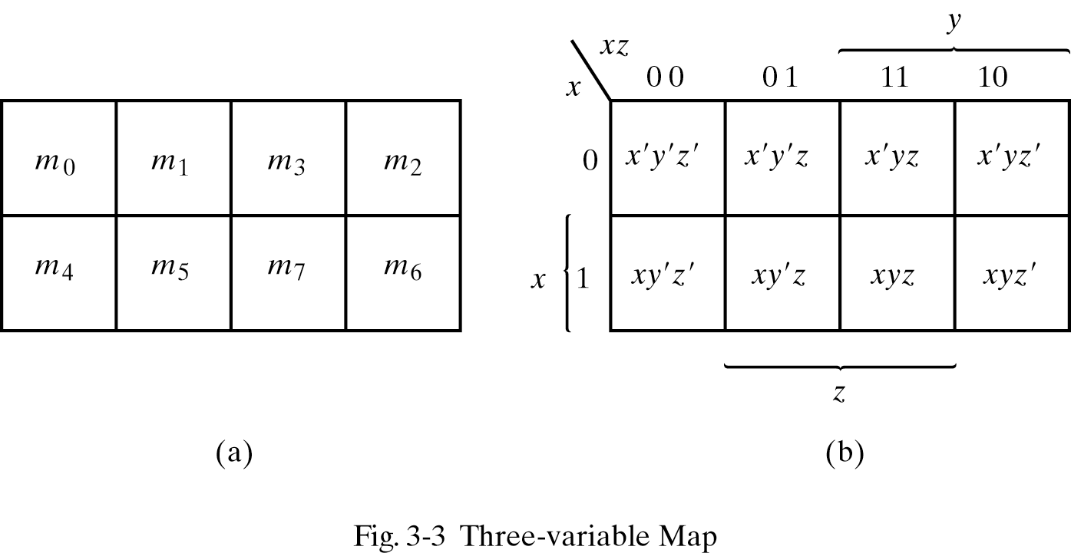


Map Simplification
Three-variable Map
  8 minterms for 3 variables
    A rectangle of 2 squares represents a product term of 2 literals
    “ 4 “ “ 1 literal
    “ 8 “ “ a logic 1
Logic function can be represented by
  1. Boolean expression 2. Truth table 3. Circuit 4. K-map

Slide 7
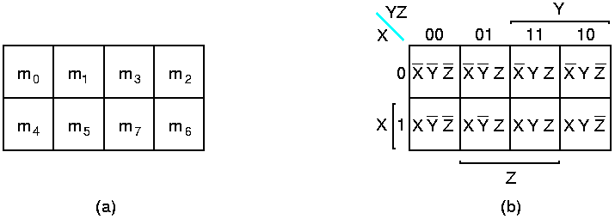
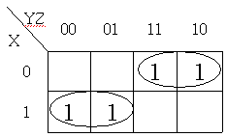
Map Simplification
  Ex3.1 F(X,Y,Z) = Σ m(2,3,4,5)
  (from K-map) F = X'Y + XY'

Slide 8
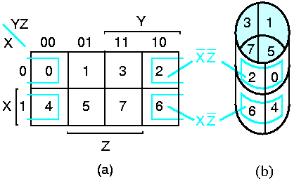
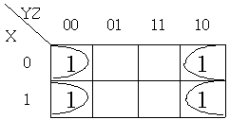
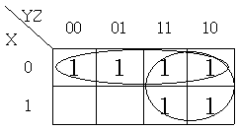
Map Simplification
  (Ex)
  (Ex) (Ex)
  m0+m2+m4+m6 = Z' m0+m1+m2+m3+m6+m7 = X' + Y

Slide 9
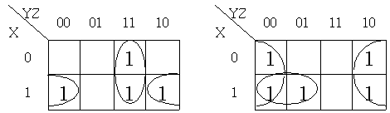
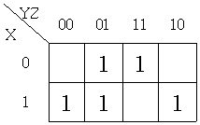
Map Simplification
  Ex3-2. F1(X,Y,Z) = Σ m(3,4,6,7) Ex3-3. F2(X,Y,Z) = Σ m(0,2,4,5,6)
  (Ex)
    F2(X,Y,Z) = Σ m(1,3,4,5,6)
  = X'Z + XZ' + XY'
  or = X'Z + XZ' + Y'Z

Slide 10
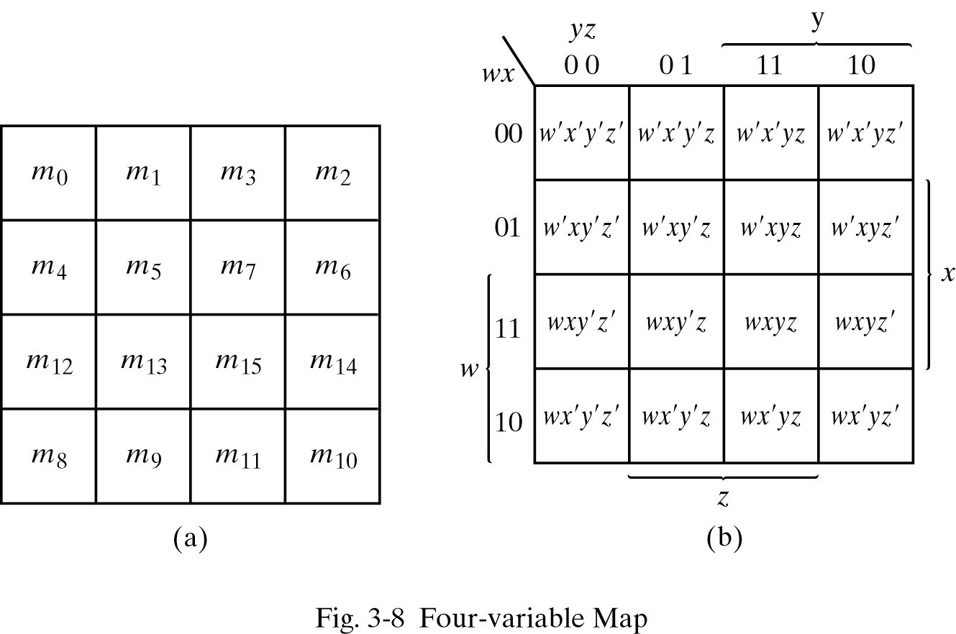
Map Simplification
Four-variable Map
  16 minterms for 4 variables

Slide 11
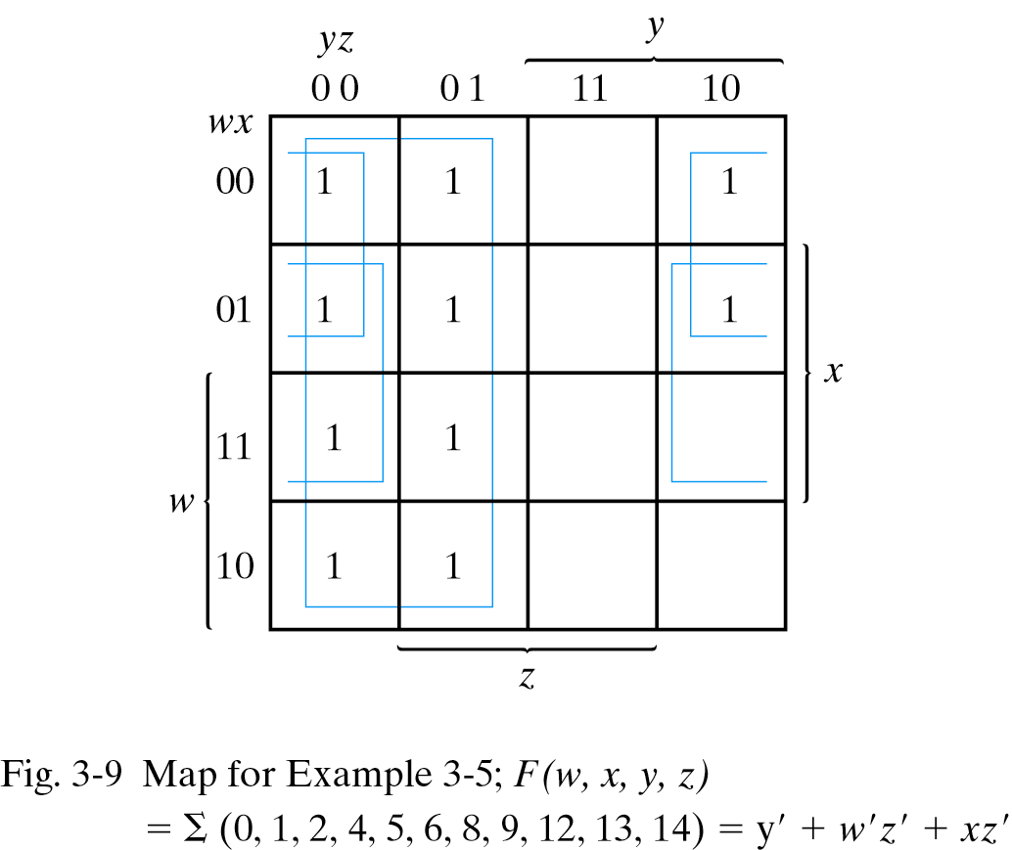
Example 3-5

Slide 12
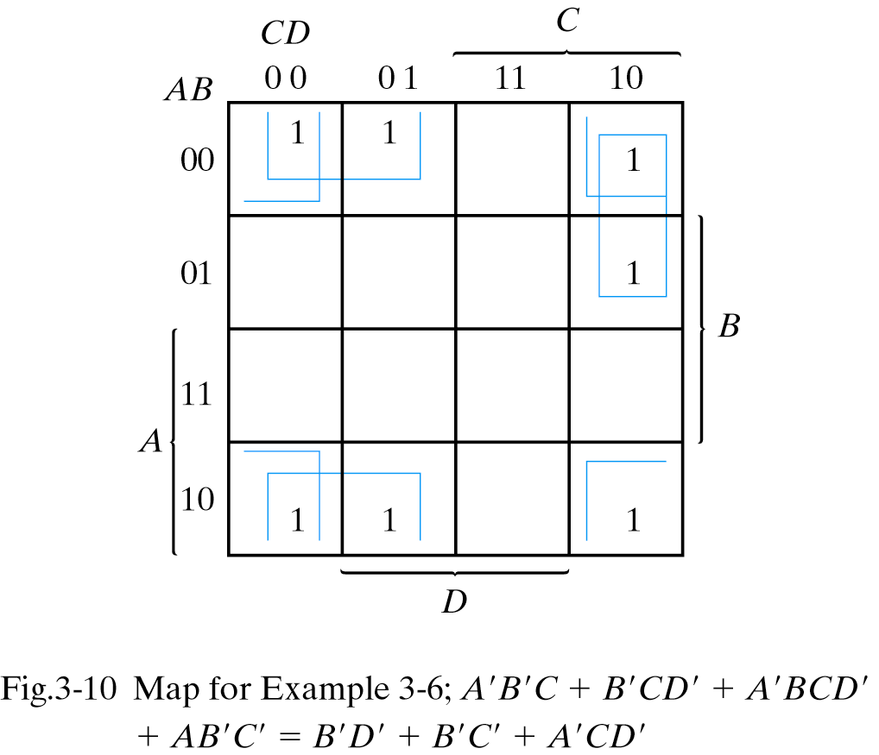
Example 3-6

Slide 13
Prime Implicants
In logic minimization
  We need to ensure that all minterms of the functions are included
  It is also necessary to minimize both the number of terms and the number of literals
Essential prime Implicants
  A product term is an implicant of a function if the function has the value 1 for all minterms of the product term
  A prime implicant is a product term obtained by combining the maximum possible number of adjacent squares in the map.
    If the removal of any literal from an implicant P results in a product term that is not an implicant of the function, then P is a prime implicant (PI)
  If a minterm of a function is included in only one prime implicant, then that prime implicant is an essential prime implicant (EPI)

Slide 14

Prime Implicants
Logic minimization procedure
  Determine all prime implicants
  Sum of all the essential prime implicants + other prime implicants to include remaining minterms
Minimal cover
  A minimal cover of a Boolean function F consists of all EPIs and a collection of the fewest, nonredundant, nonessential prime implicants (non-EPIs) that cover all of the minterms that are not covered by the EPIs of F.

Slide 15
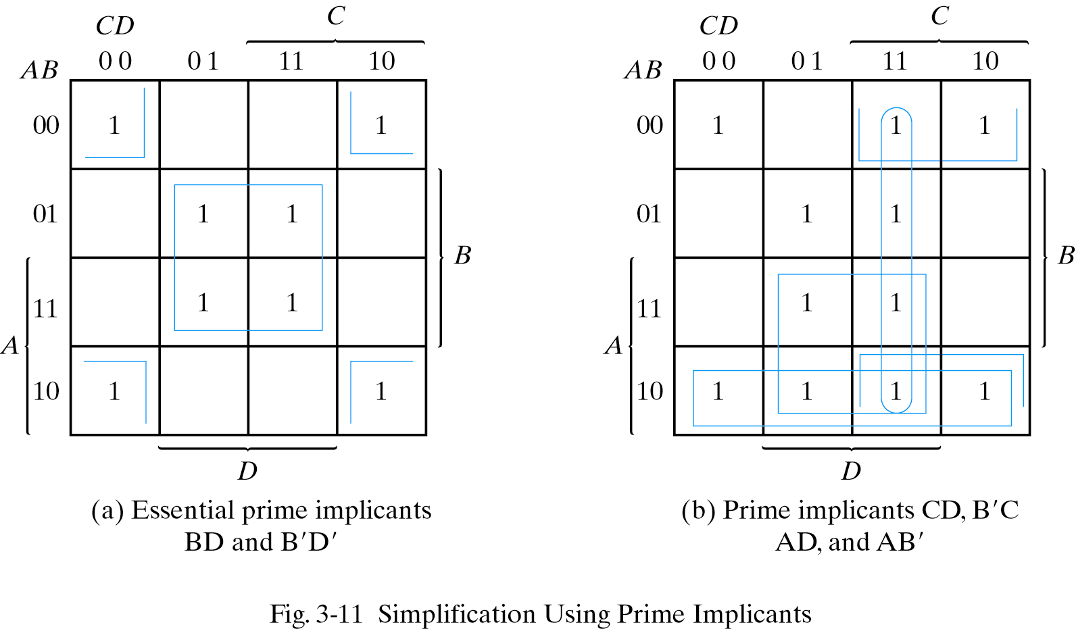
Simplification Using Prime Implicants

Slide 16
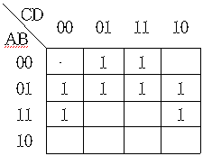
Map Simplification Example
  (Ex)
  A'D and BD': essential
  prime implicants
  A'B: not essential

Slide 17
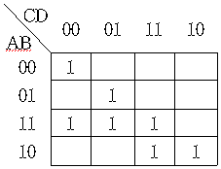
Example
  (Ex)
  A'B'C'D', BC'D, ABC', AB'C: essential prime implicants
  ACD or ABD: not essential
  F = A'B'C'D' + BC'D + ABC' + AB'C + ACD or ABD

Slide 18
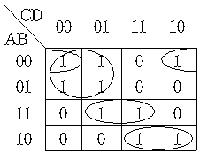
Simplification Procedure
Selection rule for non-essential prime implicants
  First, select all essential prime implicants
  Second, select a non-essential prime implicant among non-essential prime implicants that include at least one remaining minterm one by one until all minterms are covered
  Ex F(A,B,C,D) = Σ m(0,1,2,4,5,10,11,13,15)
  F = A'C' + ABD + AB'C + A'B'D'

Slide 19
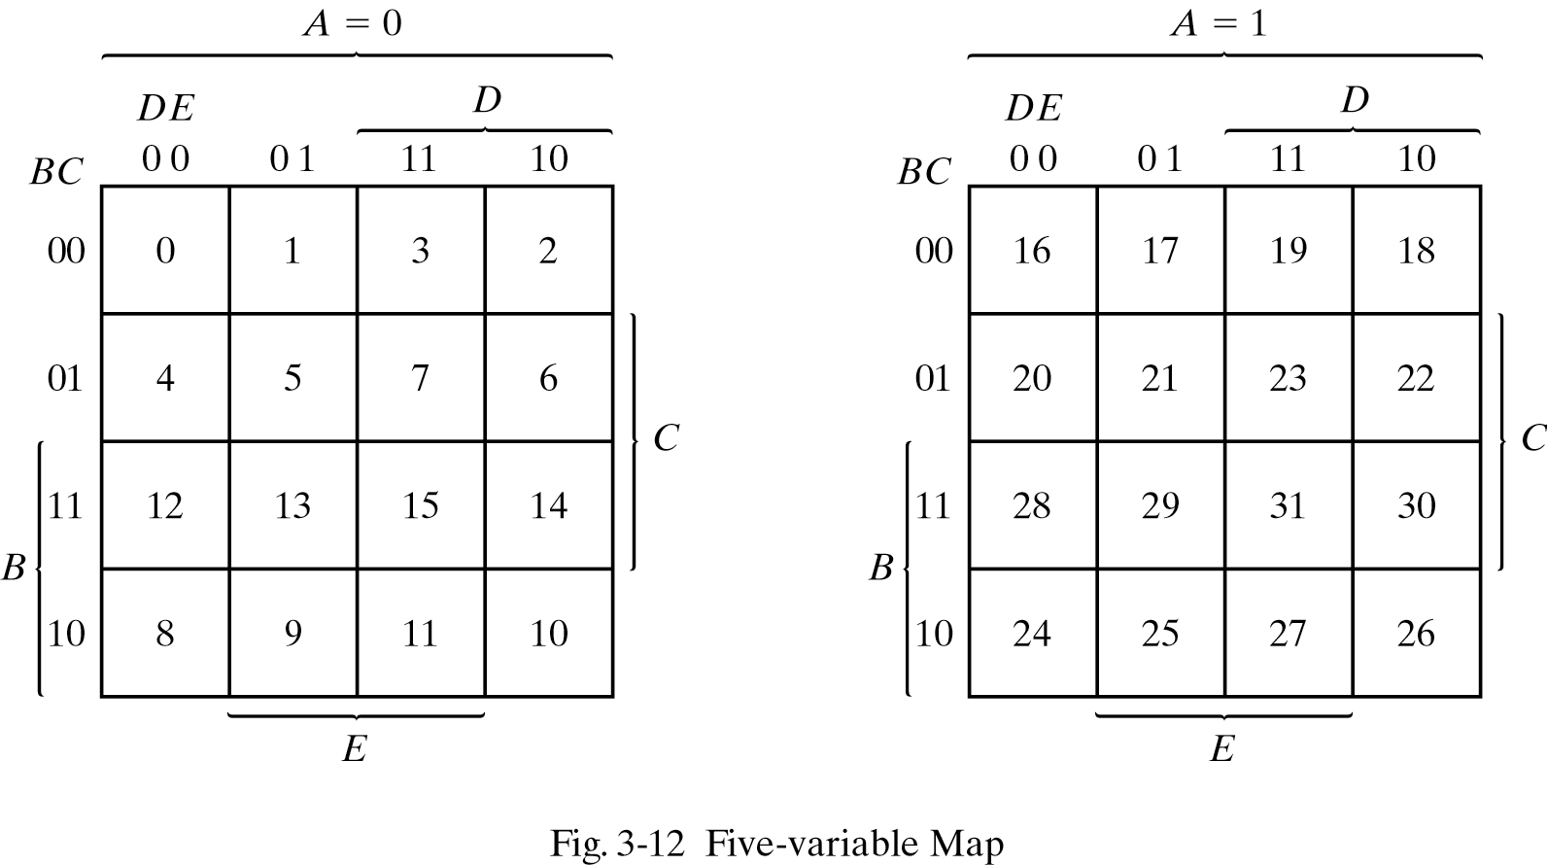
Five-Variable Map
Consider two half-maps as being one on top of the other
  Any two squares that fall one over the other are considered adjacent.

Slide 20
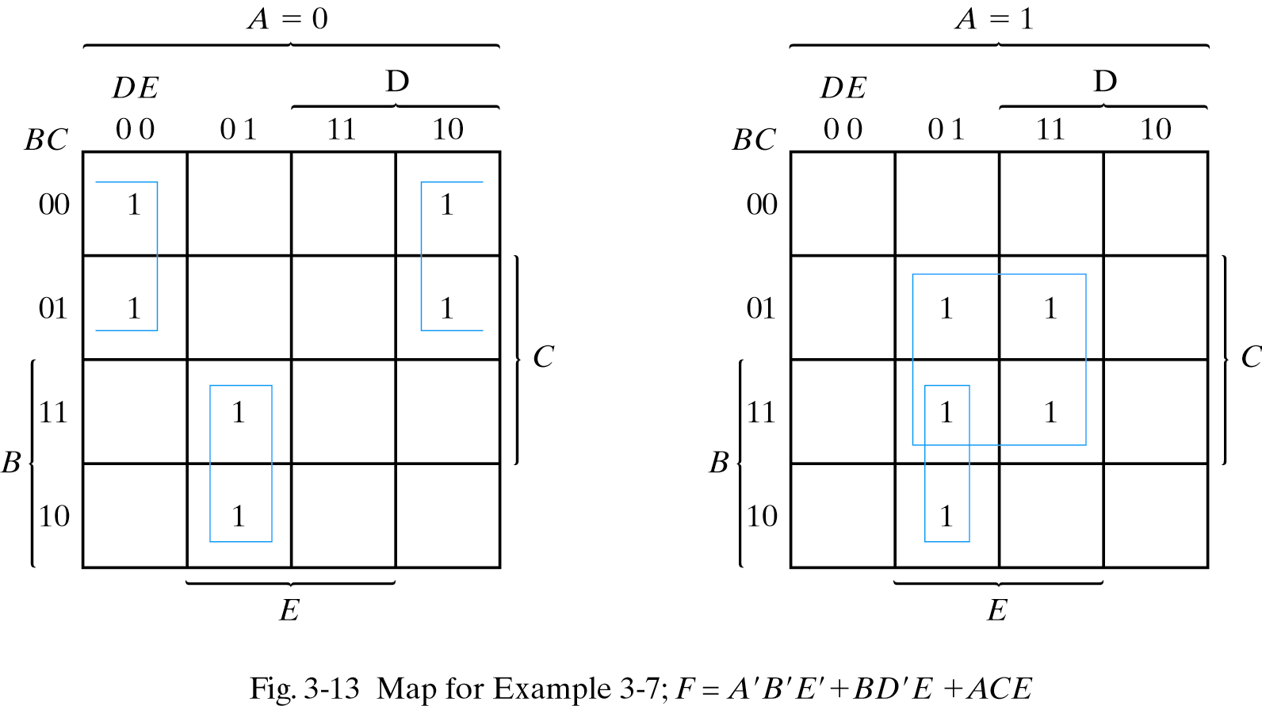
Example

Slide 21
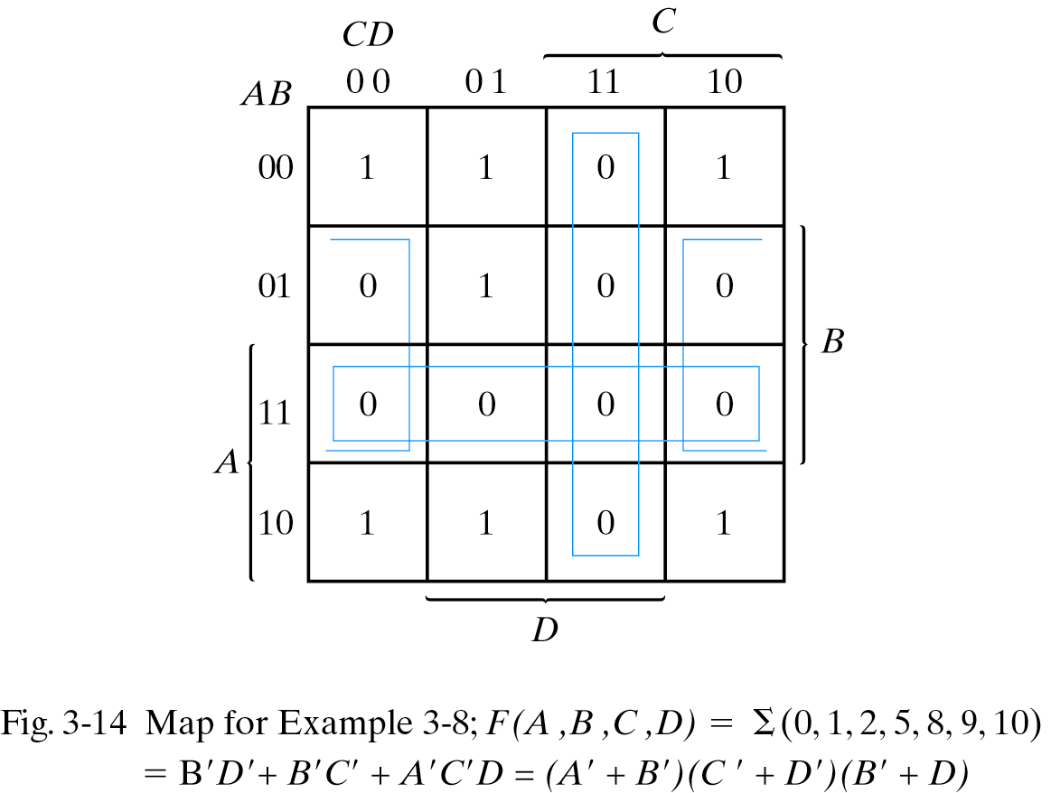
Product-of-Sums Simplification
Product-of-Sums Simplification procedure
  Complement the function and take a dual (i.e. apply DeMorgan’s theorem)
  1) Combine the squares marked with 0's and express in sum of products (F’)
  2) Convert it to product of sums (Take dual of F’)
  Ex 3-8 F(A,B,C,D) = Σ m(0,1,2,5,8,9,10)
  F' = AB + CD + BD'
        F = (A'+B')(C'+D')(B'+D)

Slide 22
Don’t Care Terms
Don't Care Conditions
  The output of a function is not specified for certain input combinations
    Some input combinations never occur (ex: BCD code 1011-1111 do not occur)
    Input combinations do occur but we do not care their output
  Marked with cross (X)
  Provide the further simplification of the function
    For logic minimization purposes, the don’t care conditions may be assumed to be either 1 or 0

Slide 23
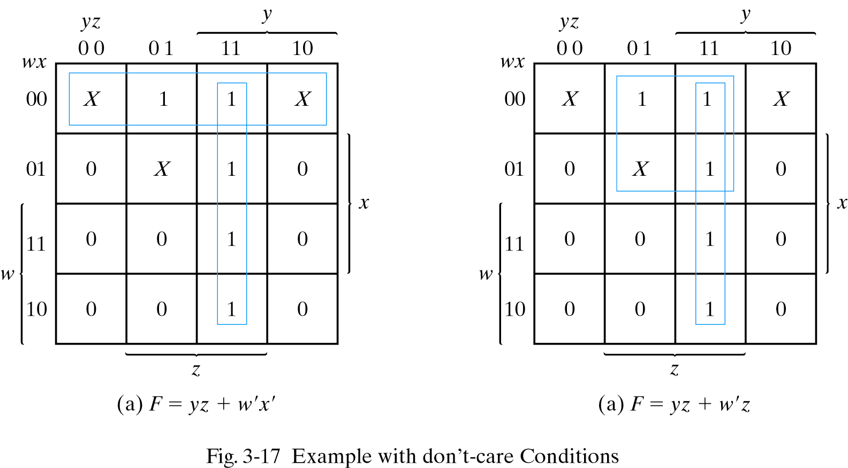
Don’t Care Conditions
  Ex 3-9 Simplify the Boolean function, F(w, x, y, z) = Σ(1,3,7,11,15)
Don’t-care conditions, d(w, x, y, z) = Σ(0, 2, 5)
  Obtain a simplified product-of-sums
F(w, x, y, z) = yz + w'x' = Σ(0, 1, 2, 3, 7, 11, 15)
F(w, x, y, z) = yz + w'z = Σ(1, 3, 5, 7, 11, 15)

Slide 24
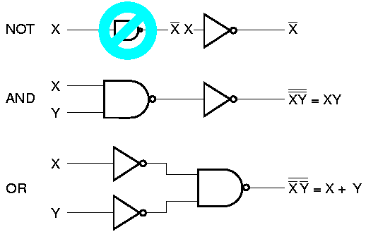
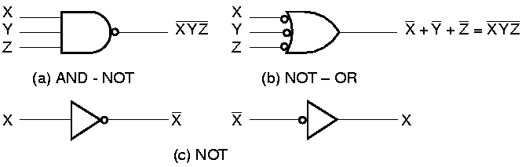
NAND and NOR Gates
NAND gate
  A universal gate
    Any digital system can be implemented with NAND gates alone (or NOR gates alone)
  Can implement NOT (inverter), AND, OR
  2 graphic symbols: AND-invert & invert-OR

Slide 25
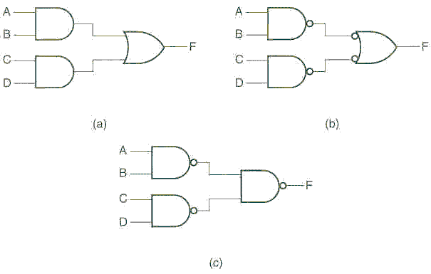
2-Level Implementation with NAND
For sum-of-products
  AND-OR 2-level implementation can be easily converted into NAND-NAND 2-level implementation
  (Ex) F = AB + CD
  F = ( (AB)' (CD)' )'
  = AB + CD

Slide 26
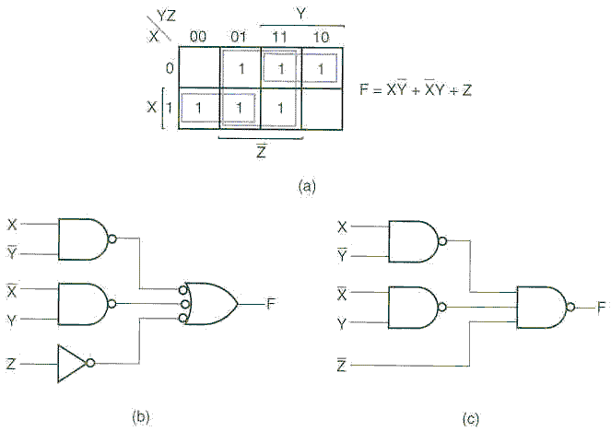
Example
  Ex 3-10 F(X,Y,Z) = Σ m(1,2,3,4,5,7)

Slide 27
2-Level NAND Implementation
Two-level NAND implementation procedure
  1. Simplify the function in sum-of-products form
  2. For product terms with 2 or more literals
    Use the same input
  For product terms with a single literal
    Invert the input
  3. Draw NAND-NAND as if AND-OR implementation

Slide 28
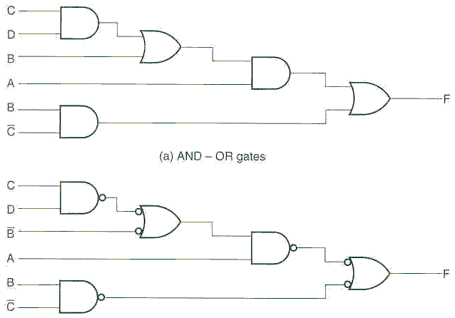
Multi-level NAND Implementation
General procedure for converting a multi-level AND-OR into all NAND design
  1) Convert all AND gates to NAND – NOT
  2) Convert all OR gates to NOT – NOT – OR
  3) Eliminate all unnecessary bubbles & insert NOT gates where
  bubbles cannot be removed
  Ex) F = A (CD + B) + BC'

Slide 29
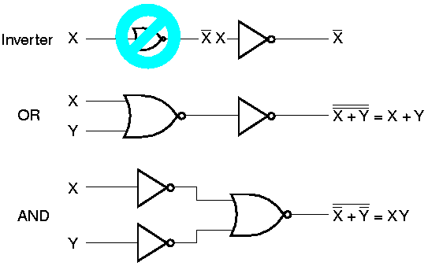
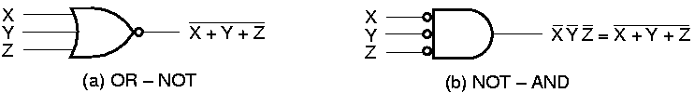
NOR Gate
NOR gate
  Dual of the NAND operation
  Another universal gate
  Can implement NOT (inverter), AND, OR
  Two graphic symbol for NOR gate

Slide 30
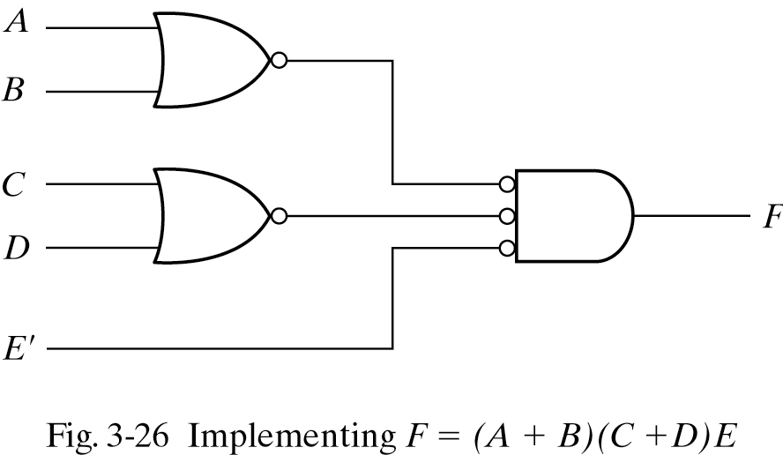
2-Level Implementation with NOR
For product-of-sums
  Easy to implement with NOR gates, if the function is in product of sums form
  OR-AND implementation can be easily converted into NOR-NOR implementation
  (Ex) F = (A + B) (C + D) E

Slide 31
NOR Implementation
Two-level NOR implementation procedure
  Simplify the function in product-of-sums form
  For sum terms with 2 or more literals, use the same input
  For sum terms with a single literal, invert the input
  Draw NOR-NOR as if OR-AND implementation
Multi-level NOR implementation
  Convert all AND gates to NOT-NOT-AND
  Convert all OR gates to NOR-NOT
  Cancel all unnecessary bubbles & insert NOTs where necessary

Slide 32
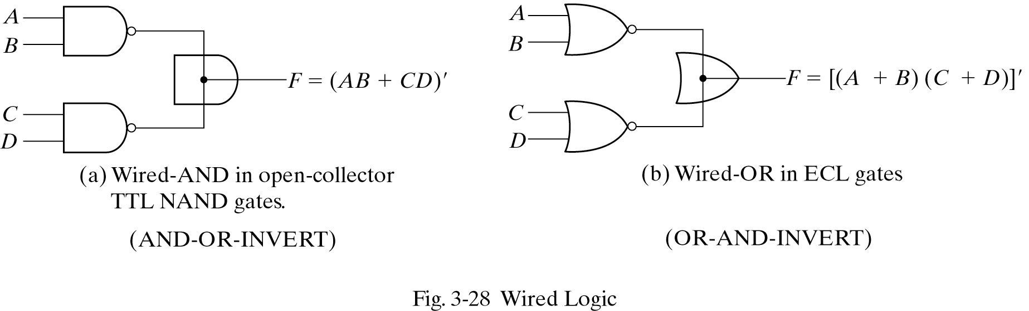
Wired Logic
NAND and NOR implementations are the most common.
Wired Logic
  Some NAND or NOR gates allow a wire connection between the outputs of two gates to provide a specific function
  Wired-AND logic in TTL
    Open-collector TTL NAND gates perform the wired-AND logic when tied together
  Wired-OR logic in ECL
    NOR output of ECL gates can be tied together to perform a wired-OR function.

Slide 33
Exclusive-OR Gate
Exclusive-OR (XOR) gate
    X ⊕ Y = X Y' + X' Y
    1 if only one variable is equal to 1, but not both
Exclusive-NOR gate (equivalence function)
    ( X ⊕ Y )' = X Y + X' Y'
    1 if both are equal to 1 or both are equal to 0

Slide 34
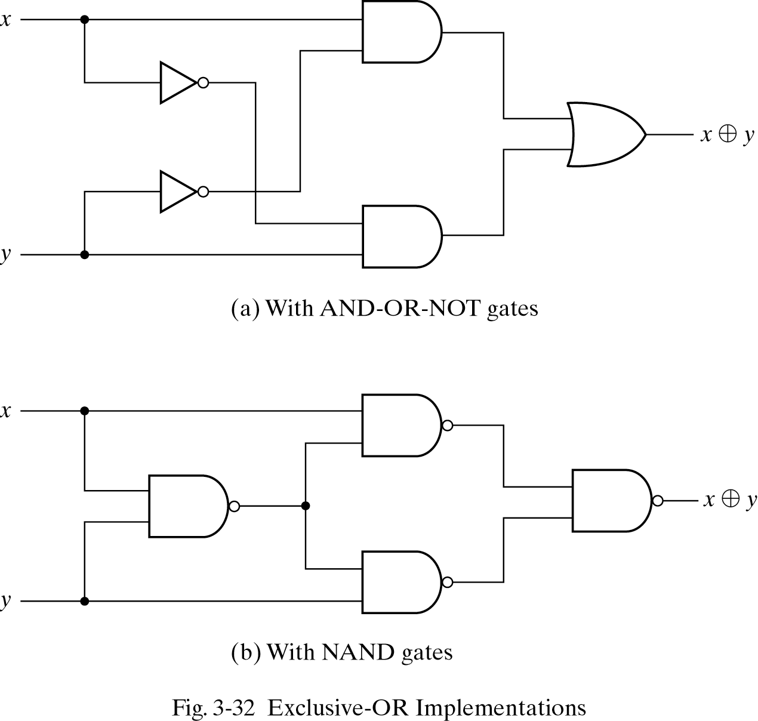
XOR Implementation
XOR implementation with NAND gates
  (xy)’x + (xy)’y = (x’ + y’)x + (x’ + y’)y = xy’ + x’y

Slide 35
Exclusive-OR Gate
Identity rules for exclusive-OR
    1. X ⊕ 0 = X 2. X ⊕ 1 = X'
    3. X ⊕ X = 0 4. X ⊕ X' = 1
    5. X ⊕ Y' = (X ⊕ Y)' 6. X' ⊕ Y = (X ⊕ Y)‘
    7. X ⊕ Y = Y ⊕ X (commutative)
    8. (X ⊕ Y) ⊕ Z = X ⊕ (Y ⊕ Z) = X ⊕ Y ⊕ Z (associative)
    (XY‘ + X’Y) ⊕ Z = (XY‘ + X’Y)Z’ + (XY + X’Y’)Z
    = XY’Z’ + X’YZ’ + XYZ + X’Y’Z
    1 if only one variable or if all the variables are equal to 1
F = w ⊕ x ⊕ y ⊕ z
  F is 1 if an odd number of variables is equal to 1

Slide 36
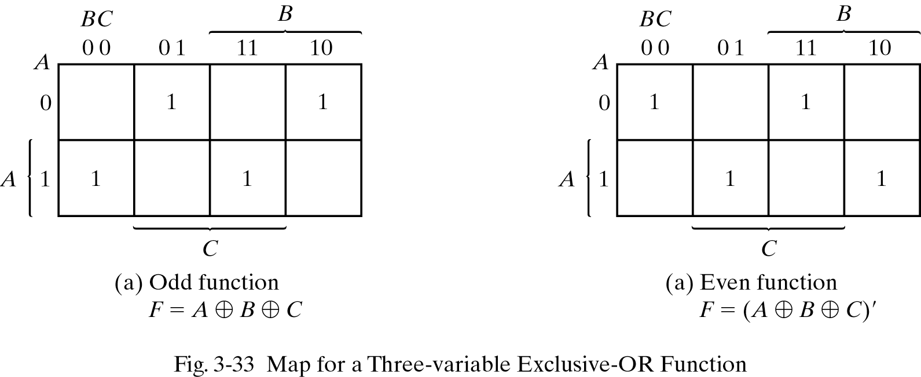
Odd/Even Function
XOR is called an odd function
  F = X ⊕ Y ⊕ Z = XY'Z' + X'YZ' + X'Y'Z + XYZ
    F is 1 if an odd number of variables are equal to 1
The complement of an odd function is an event function.

Slide 37
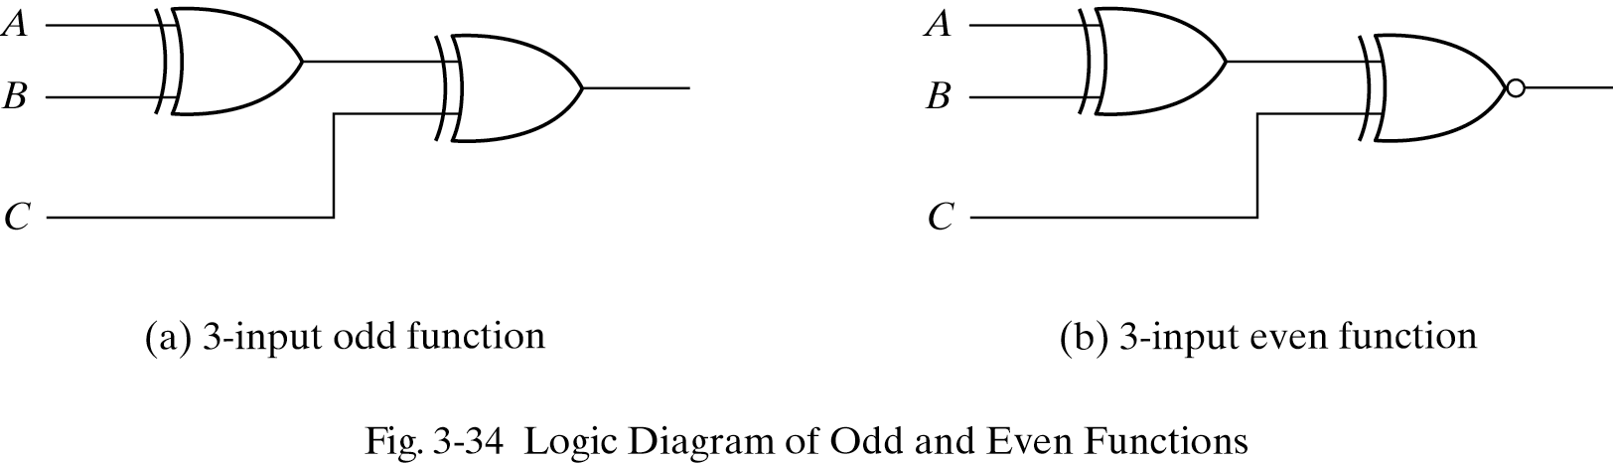
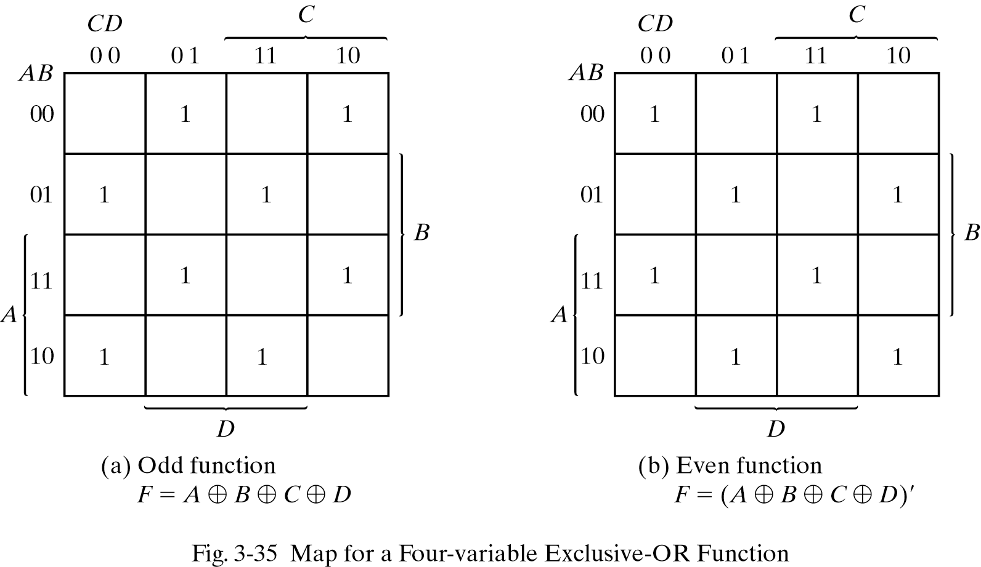
Odd/Even Function

Slide 38
Parity Generation & Checking
Parity generator – the circuit that generates the parity bit in the transmitter
  P = X ⊕ Y ⊕ Z (even parity generator for 3 variables)
    P is the odd function
  P = X ⊕ Y ⊕ Z (odd parity generator)
Parity checker – the circuit that checks the parity to detect an error
  C = X ⊕ Y ⊕ Z ⊕ P (even parity checker)
    C is 0 if there are even number of 1’s (no parity error)
    C is 1 if there are odd number of 1’s (parity error)
  C’ = X ⊕ Y ⊕ Z ⊕ P (odd parity checker)

Slide 39
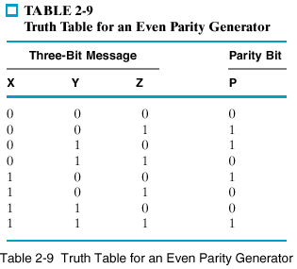
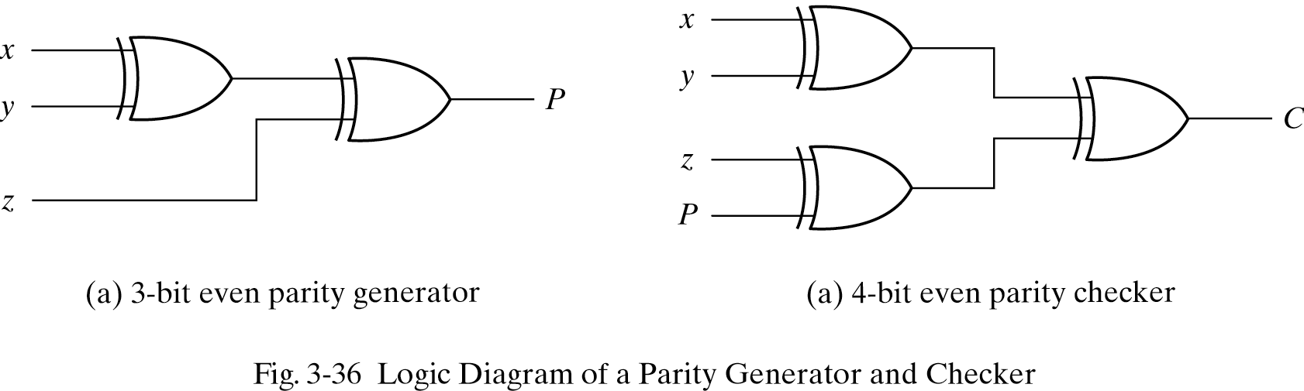
Parity Generation & Checking

Slide 40
Homework III
Read Chapter 4
PROBLEMS
  3.1
  3.2
  3.5
  3.8
  3.10
  3.13
  3.15
  3.17
  3.20
  3.28

